Slide 1
Class Component Lifecycle

Slide 2
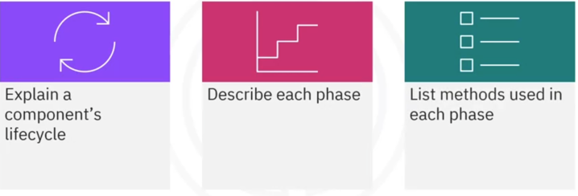
What you will learn

Slide 3
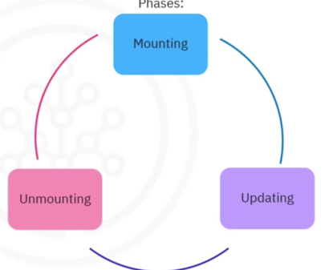
Lifecycle overview
Components have
lifecycles with three
phases
Each phase has
distinct methods

Slide 4
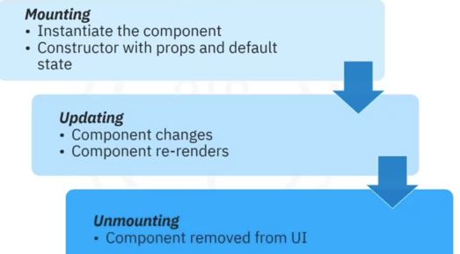
Lifecycle phase overview

Slide 5
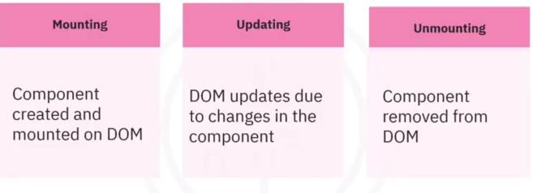
The DOM and the lifecycle
Each phase has specific methods
Automatically invoked
You have access

Slide 6

Mount Methods

Slide 7



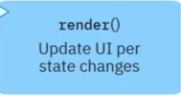
Update Methods

Slide 8
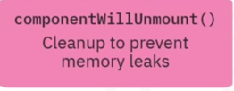

Unmount Methods

Slide 9
Recap
In this video, you learned that:
• A component's lifecycle refers to its relationship with the DOM
• The three phases in the lifecycle include mount, update, and unmount
• In the mount phase, the methods called include componentWi11Mount() and
componentDidMount()
• Methods invoked during the update phase include
• getDerivedStateFromProps()
• getSnapshotBeforeUpdate()
• componentDidUpdate()
• In the final unmount phase, React calls the componentWi11Unmount() method
• The render() method is called in both the mount and update phases

